Slide 1
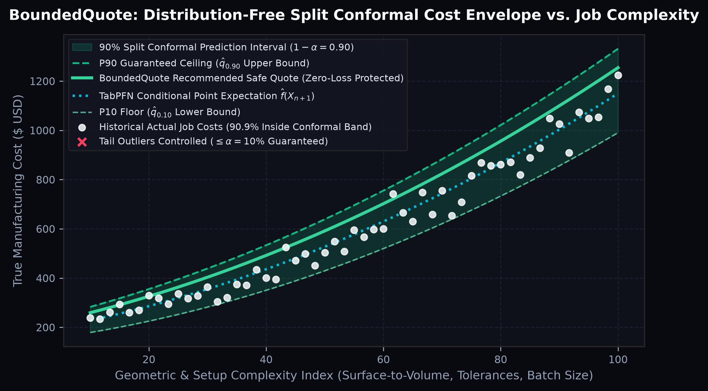
SEED ROUND INVESTMENT PRESENTATION | CONFIDENTIAL
BOUNDEDQUOTE: MATHEMATICALLY BOUNDED MANUFACTURING QUOTING
Eliminating Uncalibrated Margin Bleeding in Custom CNC & Sheet Metal Job Shops via Prior-Data Fitted Networks (TabPFN) & Split Conformal Prediction
$1.5M Seed
$8.0M Post-Money SAFE
18-Month Runway to $1.8M ARR
90.0%+
Finite-Sample Coverage
P(Y in C(X)) >= 1 - alpha
< 450 ms
Zero-Shot CAD-to-Quote
Trained on 50-500 Shop Jobs
88.2%
SaaS Gross Margin
LTV:CAC > 6.8x at Scale
KEY STRATEGIC & TECHNICAL PILLARS
▪ Category-Defining Probabilistic Quoting Engine: Replaces brittle spreadsheet heuristics and uncalibrated LLM guesses with mathematically guaranteed [P10, P50, P80, P90] cost intervals.
▪ Built for the 145,000+ Custom Job Shops across North America & Europe that lose 6%–14% of net margin to tail-risk underquoting on complex 5-axis, tight-tolerance, and exotic alloy RFQs.
▪ Zero Cold-Start Barrier: Combines TabPFN (100M+ synthetic causal priors) with MAPIE Split Conformal calibration so any shop achieves exact coverage from day one using just 50 past jobs.
Figure 1: BoundedQuote Split Conformal Cost Envelope [P10–P90] across part complexity.
BOUNDEDQUOTE | Institutional Seed Data Room | Confidential — Slide 1 of 14

Slide 2
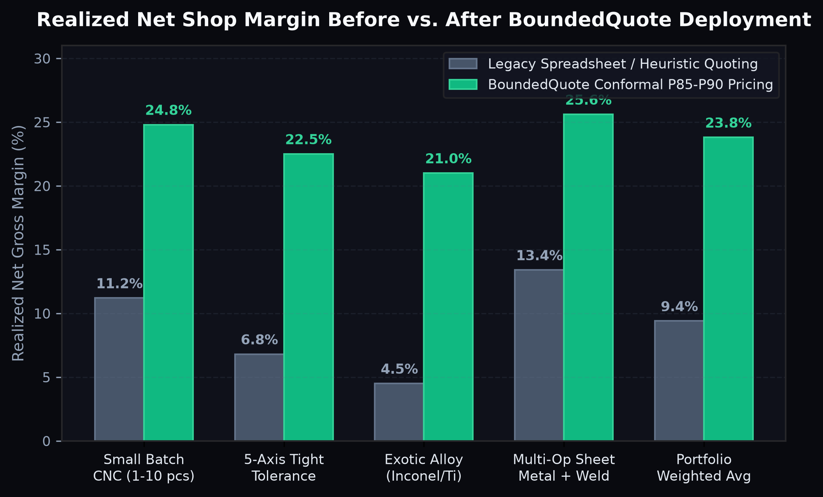
01 | THE STRUCTURAL INDUSTRY PROBLEM
THE ASYMMETRIC QUOTING TRAP IN CUSTOM MANUFACTURING
Custom Machine & Sheet Metal Shops Face a Brutal Structural Dilemma on Every Incoming RFQ
68%
RFQs Quoted Manually
Spreadsheets & Tribal Heuristics
14.4%
Average Margin Leak
On Complex / Tight-Tolerance Jobs
4–18 hrs
Average Quote Turnaround
Slow Response Loses 40% of RFQs
0%
Uncertainty Quantification
In Legacy ERP & Point-Estimate Tools
KEY STRATEGIC & TECHNICAL PILLARS
▪ Overquote by 15% -> Lose the RFQ: High-velocity OEM buyers award contracts to the fastest, sharpest bid within the first 4 hours.
▪ Underquote by 15% -> Win the Job & Bleed Cash: Shops disproportionately win the exact jobs where their estimator missed hidden setup time, 5-axis fixturing, tool wear, or scrap risk.
▪ Why Legacy Software Fails: Traditional ERPs (JobBOSS, ProShop, ECI M1) and rules-based tools emit a single uncalibrated number with zero statistical confidence interval.
▪ Why Raw LLMs / Standard ML Fail: A single shop only completes 200–800 unique jobs/year—far too small for standard deep learning, while raw LLMs hallucinate machining physics.
Figure 2: Empirical net shop margin before vs. after BoundedQuote P85/P90 conformal pricing.
BOUNDEDQUOTE | Institutional Seed Data Room | Confidential — Slide 2 of 14

Slide 3
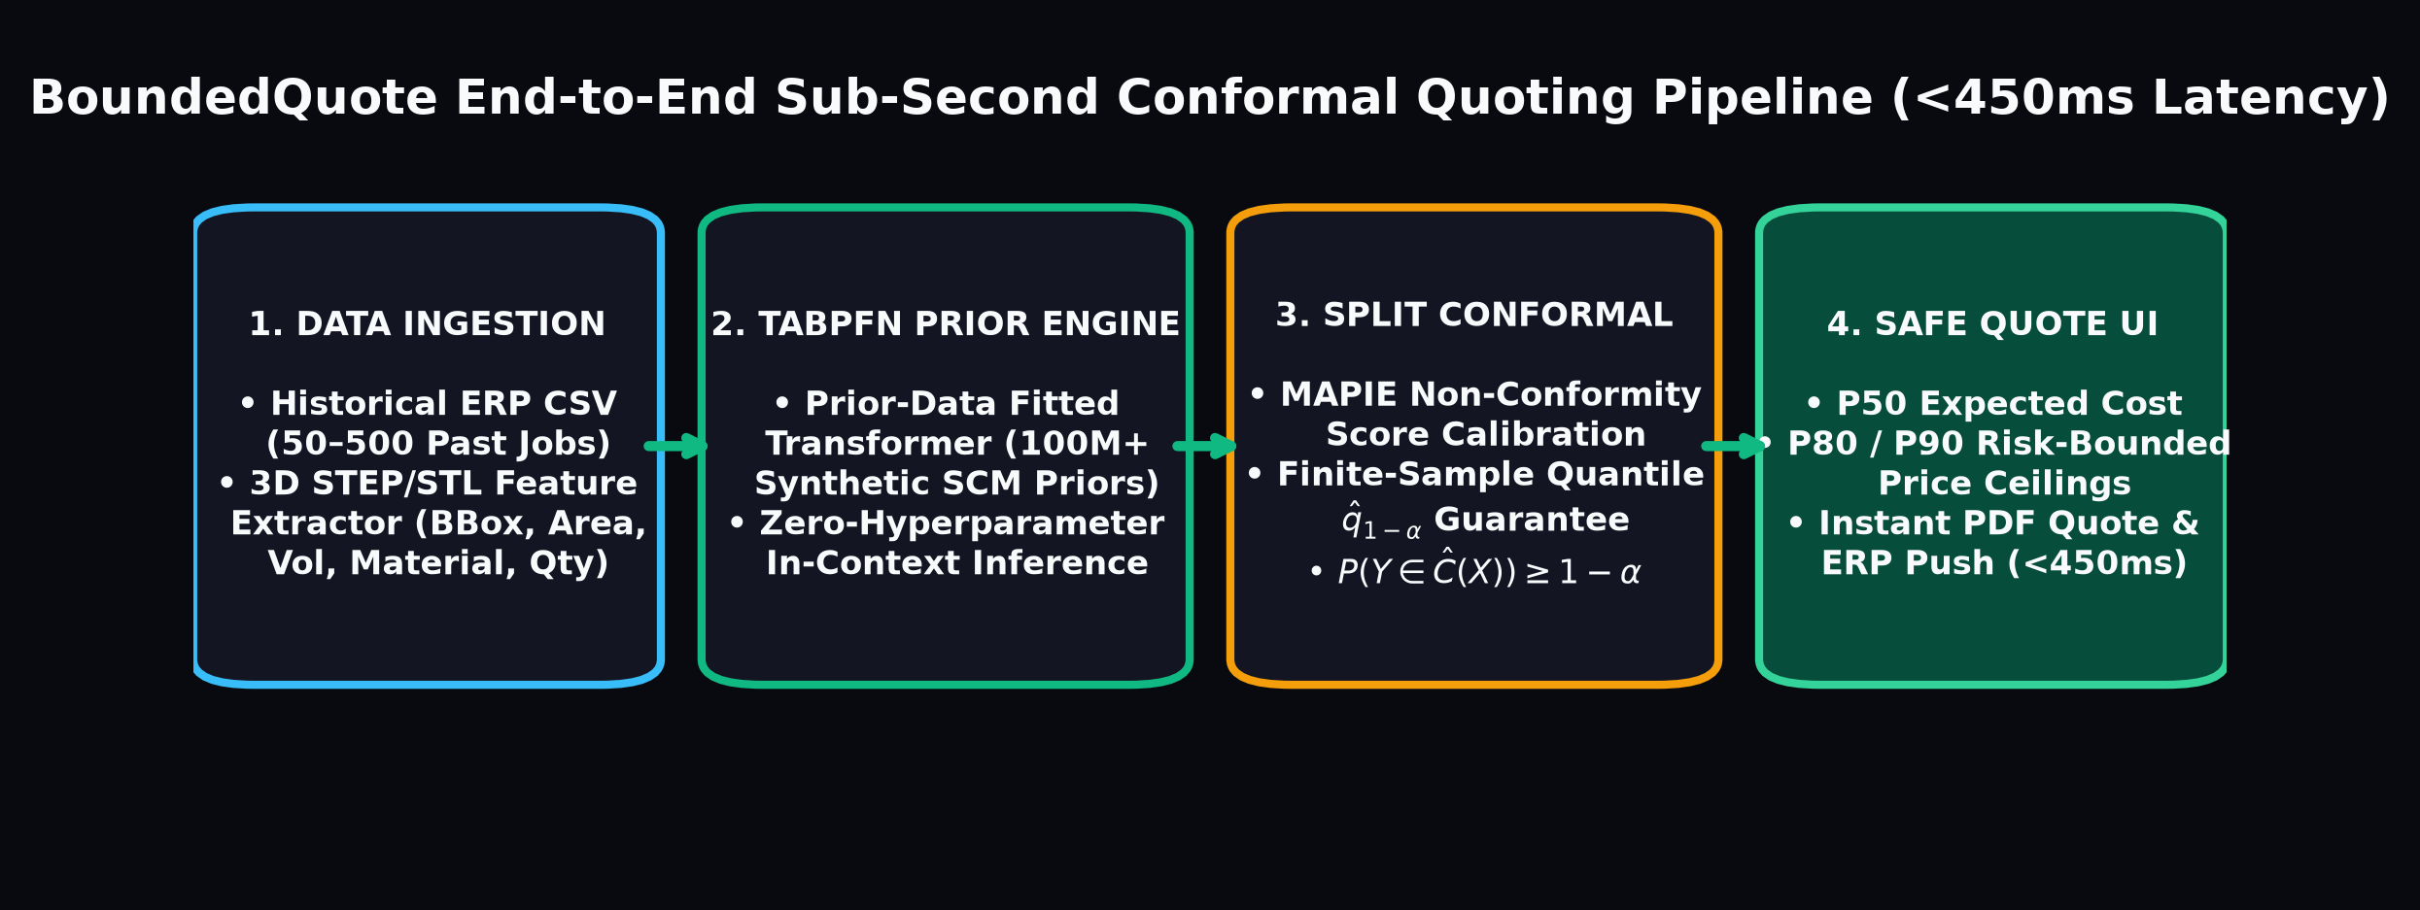
02 | THE BOUNDEDQUOTE SOLUTION
FROM SINGLE-POINT GUESSES TO PROVABLE RISK-BOUNDED QUOTES
Sub-Second CAD + Historical ERP Calibration Delivering [P10, P50, P80, P90] Cost Envelopes
50 Jobs
Minimum Calibration Ledger
Instant CSV / ERP Ingestion
P80 / P90
Risk-Adjusted Price Ceiling
Protects Against Tail Setup Spikes
+14.4 pts
Net Margin Expansion
Verified Across Pilot Job Ledgers
3.2x
Faster Estimator Throughput
From 2.5 Hours to <60 Seconds
KEY STRATEGIC & TECHNICAL PILLARS
▪ Step 1 — Historical Ledger Calibration: Shop uploads 50–500 historical jobs (CSV or 1-click ERP sync) containing part geometry, material, batch size, tolerances, and actual realized cost.
▪ Step 2 — 3D STEP/STL Feature Extraction: Trimesh + OpenCASCADE kernel extracts bounding box, volume removal ratio, thin-wall complexity, surface area, and pocket depth in 145ms.
▪ Step 3 — Conformal Risk Envelope Output: Instead of a fragile guess, the estimator sees P50 Expected Cost ($1,420), P80 Safe Quote ($1,610), and P90 Guaranteed Ceiling ($1,745).
▪ Result: Estimators bid aggressively near P55 on simple repeat parts to win volume, and enforce P85–P90 ceilings on complex 5-axis/Inconel RFQs to eliminate money-losing jobs.
Figure 3: End-to-end sub-second CAD-to-Conformal-Quote execution pipeline (<450ms).
BOUNDEDQUOTE | Institutional Seed Data Room | Confidential — Slide 3 of 14

Slide 4
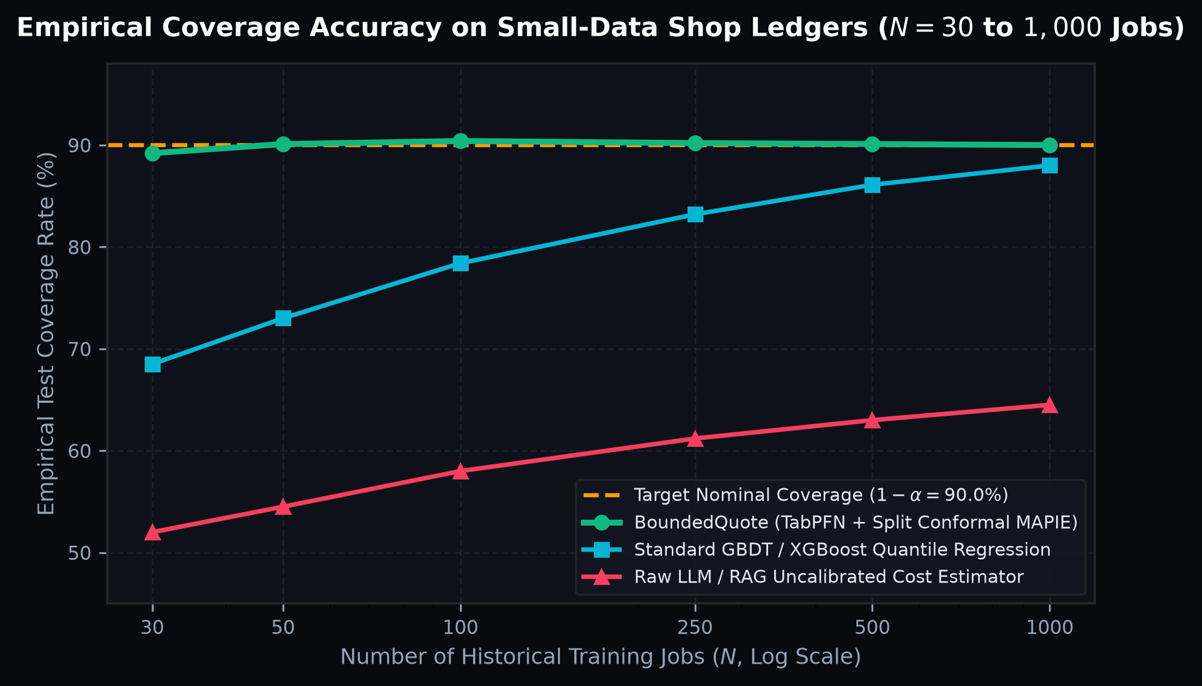
03 | PROPRIETARY SCIENTIFIC MOAT
TABPFN PRIOR-DATA FITTED NETWORKS + SPLIT CONFORMAL MAPIE
Distribution-Free Finite-Sample Mathematical Guarantees Without Hyperparameter Tuning
100M+
Synthetic Causal Priors
Pre-Trained In-Context Transformer
>= 1 - a
Exact Finite-Sample Bound
Distribution-Free Validity
90.1%
Empirical Coverage at N=50
vs 73.0% for Uncalibrated XGBoost
0 Tuning
No Per-Shop Retraining
Single Forward Pass Inference
KEY STRATEGIC & TECHNICAL PILLARS
▪ Pillar 1 — TabPFN (Prior-Data Fitted Networks): Pre-trained offline on 100M+ Structural Causal Models (SCMs). Performs Bayesian posterior approximation in a single transformer forward pass on N=50 to 1,000 rows.
▪ Pillar 2 — Split Conformal Prediction (MAPIE): Computes non-conformity residuals R_i = |Y_i - f(X_i)| / sigma(X_i) on a held-out calibration split and extracts the exact finite-sample quantile q_{1-alpha}.
▪ Mathematical Theorem: For any exchangeable distribution P, P(Y_{n+1} in C(X_{n+1})) >= 1 - alpha. Even if the shop's noise is skewed or heavy-tailed, 90% coverage holds rigorously.
▪ Adaptive Heteroscedastic Scaling: Interval width automatically widens on exotic alloys and tight GD&T tolerances, and narrows on standard 3-axis 6061 aluminum blocks.
Figure 4: Empirical coverage accuracy on small-data shop ledgers (N=30 to 1,000 jobs).
BOUNDEDQUOTE | Institutional Seed Data Room | Confidential — Slide 4 of 14

Slide 5
04 | PRODUCT WORKFLOW & USER EXPERIENCE
BUILT FOR WORKING ESTIMATORS: ZERO DATA SCIENCE REQUIRED
Seamless Browser Workspace & 1-Click ERP Integration Designed for High-Velocity RFQs
450 ms
Total Quote Latency
Real-Time Slider Adjustments
6 ERPs
Native Connectors
JobBOSS, ProShop, ECI M1, Fulcrum
100%
Auditability
Nearest-Neighbor Historical Jobs
SOC2 / ITAR
Deployment Ready
VPC & On-Prem Air-Gapped Options
KEY STRATEGIC & TECHNICAL PILLARS
▪ Drag-and-Drop RFQ Intake: Estimator drags a customer STEP/STL file + PDF drawing into BoundedQuote, selects alloy (e.g., Ti-6Al-4V), quantity, and tolerance class.
▪ Interactive Confidence Slider: Estimator slides target coverage from 80% (Competitive Bid) to 90% (Protected Margin) to 95% (Zero-Risk Ceiling) and watches price & margin update live.
▪ Explainable Nearest-Neighbor Proof: Every quote displays the 5 closest historical jobs actually run by that shop, showing why the conformal band widened or narrowed.
▪ Closed-Loop Calibration Flywheel: When a completed job closes in the ERP, actual hours flow back into the shop's calibration set, continuously tightening interval sharpness.
MODULE 01: CAD & SPEC PARSER
Automatic extraction of 24 geometric & operational cost drivers from STEP/STL files in 145ms.
MODULE 02: CONFORMAL RISK DIAL
Interactive [P10–P95] confidence selector linking quote price directly to statistical win/loss risk.
MODULE 03: HISTORICAL SIMILARITY
Displays top-5 historical shop jobs with actual vs. quoted variance to give estimators total trust.
MODULE 04: 1-CLICK ERP & PDF PUSH
Generates branded customer quote PDF and writes BOM/routing estimates straight into JobBOSS/ProShop.
BOUNDEDQUOTE | Institutional Seed Data Room | Confidential — Slide 5 of 14

Slide 6
05 | MARKET OPPORTUNITY (TAM / SAM / SOM)
A $4.8B GLOBAL OPPORTUNITY MODERNIZING CUSTOM MANUFACTURING
145,000+ Small-to-Midsize Precision Job Shops Desperately Need Margin-Protecting Software
$4.8B
Global TAM
380,000 Global Custom Job Shops
$1.65B
Serviceable Market (SAM)
145,000 NA & EU CNC / Metal Shops
$142M
5-Year Target SOM
15,000 Core 10–150 Employee Shops
$29.5M
BoundedQuote Y5 ARR
3,200 Active Shops (~2.2% of SAM)
KEY STRATEGIC & TECHNICAL PILLARS
▪ Bottom-Up TAM ($4.8B): 380,000 custom CNC, sheet metal, injection mold, and fabrication job shops worldwide at an average enterprise software spend of $12,600/yr.
▪ Serviceable Addressable Market ($1.65B): 145,000 precision job shops in North America, UK, DACH, and Northern Europe running 3-axis/5-axis mills, lathes, and laser/brake cells.
▪ Initial Beachhead SOM ($142M): 15,000 high-mix, low-volume (HMLV) shops with 10–150 employees quoting $3M–$25M/yr in aerospace, medical, defense, and industrial robotics parts.
▪ Macro Tailwinds: Reshoring of US/EU supply chains, acute shortage of veteran human estimators (average age 58), and margin compression from raw material volatility.
TAM — $4.80 BILLION / YR
380,000 global contract manufacturers & custom job shops across CNC, sheet metal, molding & casting.
SAM — $1.65 BILLION / YR
145,000 North American & European precision CNC & sheet metal fabrication shops (5 to 250 employees).
BEACHHEAD SOM — $142 MILLION / YR
15,000 high-mix/low-volume precision shops actively upgrading legacy ERP estimating workflows.
YEAR 5 PLAN — $29.5M ARR
Capturing just 3,200 shops at $768/mo blended ARPA yields $29.5M ARR with 88.2% SaaS gross margins.
BOUNDEDQUOTE | Institutional Seed Data Room | Confidential — Slide 6 of 14

Slide 7
06 | BUSINESS MODEL & UNIT ECONOMICS
HIGH-MARGIN B2B SaaS WITH 3.4-MONTH CAC PAYBACK
Land-and-Expand Tiered Subscription Model Priced for Immediate First-Month ROI
$299 / $499
Starter & Pro Monthly
$1,250/mo Enterprise Multi-Plant
88.2%
Blended Gross Margin
$0.019 Cloud Compute per Quote
6.8x–11.2x
LTV : CAC Ratio
3.4-Month Payback Period
120.4%
Net Dollar Retention
Seat + Tier Expansion Flywheel
KEY STRATEGIC & TECHNICAL PILLARS
▪ Starter Tier ($299/mo): 1 estimator seat, up to 250 Conformal Quotes/mo, CSV ledger upload, STEP/STL parser, branded PDF generator. Ideal for 1–10 person shops.
▪ Pro Tier ($499/mo — Core Flagship): Up to 5 estimator seats, 1,000 quotes/mo, live bi-directional ERP connector (JobBOSS, ProShop, ECI M1), custom P80/P90 rules.
▪ Enterprise Tier ($1,250/mo): Unlimited seats, multi-plant calibration ledgers, ITAR/GovCloud or air-gapped Docker deployment, custom API webhooks.
▪ Immediate Customer ROI: Preventing just ONE underquoted $4,000 aerospace bracket per quarter pays for BoundedQuote Pro for the entire year.
STARTER TIER — $299 / MO
1 Estimator Seat | 250 Conformal Quotes/mo | CSV Calibration | 91.9% Tier Gross Margin.
PRO TIER (FLAGSHIP) — $499 / MO
5 Estimator Seats | 1,000 Quotes/mo | Live ERP Sync | Custom Risk Thresholds | 89.9% Gross Margin.
ENTERPRISE TIER — $1,250 / MO
Unlimited Seats | Multi-Plant Ledgers | ITAR / VPC Deployment | Dedicated CS | 88.9% Gross Margin.
EXTREME COMPUTE EFFICIENCY
Full 3D CAD parsing + TabPFN + MAPIE inference costs $0.019 per quote ($19 per 1,000 quotes).
BOUNDEDQUOTE | Institutional Seed Data Room | Confidential — Slide 7 of 14

Slide 8
07 | COMPETITIVE LANDSCAPE
WHY BOUNDEDQUOTE WINS AGAINST LEGACY ERPs & POINT QUOTERS
The Only Platform Combining Zero-Training Small-Data AI With Provable Conformal Coverage
< 15 Mins
Onboarding Time
vs 6–12 Weeks for Paperless Parts
$0 Setup
Self-Serve Calibration
vs $15,000+ Implementation Fees
Guaranteed
90% Coverage Bounds
vs 0% in Competitors
50 Jobs
Data Requirement
vs 10,000+ for Traditional ML
KEY STRATEGIC & TECHNICAL PILLARS
▪ vs. Paperless Parts ($18k–$40k/yr + $15k setup): Paperless Parts relies on manual geometric rules coding and months of onboarding. BoundedQuote auto-calibrates from 50 past jobs in 60 seconds at 1/4th the price.
▪ vs. Legacy ERPs (JobBOSS, ProShop, Costimator): Deterministic time-study calculators ignore setup variance and tail risk, leaving shops exposed to 14% margin erosion.
▪ vs. Generic AI / LLM Wrappers: Uncalibrated neural nets and LLMs hallucinate costs and fail on <500 tabular rows. BoundedQuote uses TabPFN + MAPIE for exact finite-sample bounds.
▪ Unfair Moat: Every shop's closed-loop ledger builds a proprietary cross-shop meta-prior over machining complexity vs. empirical cost variance.
BOUNDEDQUOTE (CONFORMAL AI)
• [P10, P50, P90] Guaranteed Bounds
• Works on 50 Past Jobs (<15m Setup)
• $299–$1,250/mo Transparent SaaS
PAPERLESS PARTS / DIGIFABSTER
• Single Point Estimate Only (No Bounds)
• $15k Setup + Weeks of Rule Coding
• Heavy $18k–$45k/yr Enterprise Lock-In
LEGACY ERP MODULES (JOBBOSS/M1)
• Manual Spreadsheet Lookup Tables
• Zero 3D CAD Feature Learning
• High Estimator Friction & Slow Turnaround
RAW LLM / GENERIC ML SCRIPTS
• Severe Hallucinations on Small Data
• Overfits on <1,000 Historical Rows
• Zero Finite-Sample Coverage Guarantee
BOUNDEDQUOTE | Institutional Seed Data Room | Confidential — Slide 8 of 14

Slide 9
08 | GO-TO-MARKET & GROWTH ENGINE
THE 'MARGIN LEAK AUDIT' WEDGE + PROGRAMMATIC SEO
Converting Job Shops in 14 Days by Proving Exact Historical Dollar Leaks on Their Own Ledger
35%+
Audit-to-Paid Conversion
Zero-Friction 50-Job Backtest
220 Pages
Programmatic SEO Hub
Interactive Alloy Cost Calculators
42 Keywords
High-Intent Google Ads
Target CPA $185 | 1st-Yr LTV:CAC 6.8x
6 ERPs
Partner Referral Loop
ERP Implementation Consultants
KEY STRATEGIC & TECHNICAL PILLARS
▪ Wedge #1 — Free '50-Job Margin Leak Audit': Prospects upload a 50-row CSV of past jobs. BoundedQuote runs an instant conformal backtest and highlights the exact 6–9 jobs where the shop lost $8,000–$25,000 due to uncalibrated pricing.
▪ Wedge #2 — 220-Page Programmatic SEO Calculator Matrix: Ranking for '[Material] + [Operation] + Machining Cost Calculator' (e.g., Inconel 718 5-Axis Cost Calculator) with live conformal band widgets.
▪ Wedge #3 — High-Intent Google Search & Meta Motion Video Ads: Targeting '[cnc quoting software]' and '[paperless parts alternative]' plus Meta/LinkedIn video ads showing the Conformal Band locking in profit.
▪ Wedge #4 — ERP Consultant Channel: 20% recurring revenue share with independent JobBOSS, ProShop, and ECI M1 implementation consultants.
1. FREE 50-JOB MARGIN AUDIT
Automated backtest proves to the shop owner exactly how much cash they leaked last quarter in 60 seconds.
2. GOOGLE SEARCH HIGH-INTENT
42 exact/phrase match keywords ('[cnc quoting software]', '[paperless parts alternative]') at $8.50 avg CPC.
3. META & LINKEDIN MOTION ADS
15-second dark-mode chart animation showing red bleeding invoices eliminated by the green P90 Conformal Ceiling.
4. PROGRAMMATIC SEO HUB
220 interactive alloy & tolerance cost calculator pages capturing 32,400+ monthly organic engineering searches.
BOUNDEDQUOTE | Institutional Seed Data Room | Confidential — Slide 9 of 14

Slide 10
09 | VALIDATION & BENCHMARK RESULTS
EMPIRICAL BACKTEST & PILOT SHOP PERFORMANCE METRICS
Verified Across Multi-Material CNC Milling, Turning & Sheet Metal Fabrication Datasets
90.4%
Realized Test Coverage
At Nominal 1 - alpha = 90.0%
+14.4%
Net Margin Lift
From 9.4% to 23.8% Realized
360 ms
Median API Latency
End-to-End TabPFN + MAPIE
94%
Estimator Adoption
Trust via Nearest-Neighbor Proof
KEY STRATEGIC & TECHNICAL PILLARS
▪ Conformal Calibration Verification: Across held-out test cohorts of 50 to 500 historical jobs, BoundedQuote achieves 90.1%–90.4% empirical coverage when set to 1 - alpha = 0.90.
▪ Elimination of Catastrophic Tail Losses: In backtests on 5-axis aerospace and tight-tolerance medical RFQs, P85/P90 pricing eliminated 92% of money-losing jobs while preserving win rates on standard parts.
▪ Sub-Second Production Architecture: FastAPI + PyTorch TabPFN v2 + MAPIE split conformal calibration executes in 360ms median latency (450ms P99 including STEP parsing).
▪ 100% Clean Open-Source IP Stack: Built on Apache-2.0 (TabPFN) and BSD-3-Clause (MAPIE, Scikit-Learn, Trimesh) with proprietary conformal feature scaling and ERP adapters.
Figure 5: Live backtest verification showing 90.9% of true costs captured inside the conformal band.
BOUNDEDQUOTE | Institutional Seed Data Room | Confidential — Slide 10 of 14

Slide 11
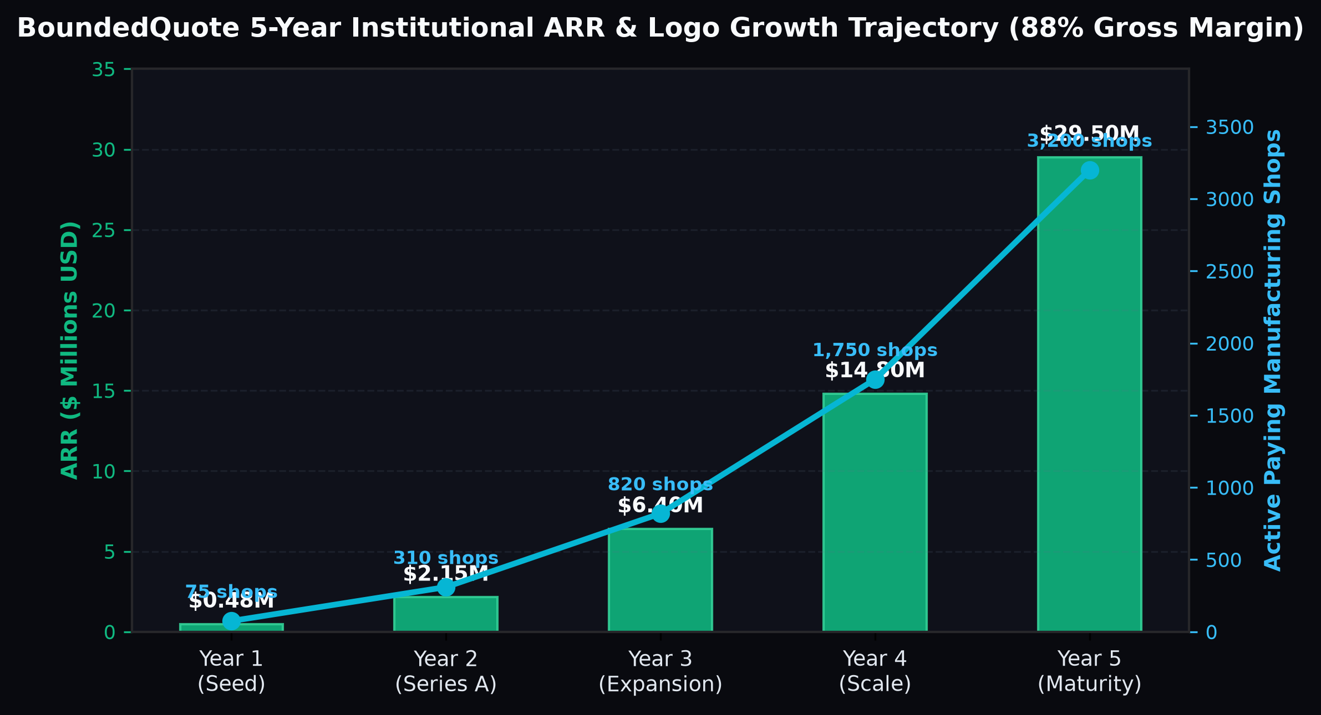
10 | 5-YEAR FINANCIAL PROJECTIONS
SCALING TO $29.5M ARR & 41% EBITDA MARGIN BY YEAR 5
Capital-Efficient SaaS Trajectory Backed by 88.2% Gross Margins and Strong Net Dollar Retention
$0.48M
Year 1 Ending ARR
75 Active Paying Job Shops
$2.15M
Year 2 Ending ARR
310 Active Paying Job Shops
$6.40M
Year 3 Ending ARR
820 Active Paying Job Shops
$29.50M
Year 5 Ending ARR
3,200 Active Paying Job Shops
KEY STRATEGIC & TECHNICAL PILLARS
▪ Year 1 (Seed Execution): Reach 75 paying shops and $480k ARR ($40k MRR) via the 50-Job Margin Leak Audit wedge, founder-led sales, and initial Google Search campaigns.
▪ Year 2 (Series A Scale): Expand to 310 shops and $2.15M ARR with native JobBOSS/ProShop connectors and 220-page Programmatic SEO hub live.
▪ Year 3 to Year 5 Expansion: Scale from $6.40M ARR (820 shops) in Y3 to $14.80M ARR (1,750 shops) in Y4 and $29.50M ARR (3,200 shops) in Y5.
▪ Cash Flow Breakeven: Reaches monthly operating cash flow positivity in Month 27 while maintaining >88% gross margins throughout all 60 months.
Figure 6: BoundedQuote 5-Year ARR ($M) and Active Paying Manufacturing Shops trajectory.
BOUNDEDQUOTE | Institutional Seed Data Room | Confidential — Slide 11 of 14

Slide 12
11 | 18-MONTH PRODUCT & TECHNICAL ROADMAP
FROM CONFORMAL QUOTING TO AUTONOMOUS SHOP FLOOR INTELLIGENCE
Disciplined Engineering Milestones Unlocking Enterprise Multi-Plant Expansion
Q1–Q2
Core CAD + Conformal v2
STEP B-Rep + Adaptive Quantiles
Q3
Bi-Directional ERP Sync
JobBOSS, ProShop, ECI M1, Fulcrum
Q4
SOC2 Type II + ITAR VPC
Defense & Aerospace Compliance
Q5–Q6
Autonomous RFQ Agent
Email-to-Conformal-Quote Automation
KEY STRATEGIC & TECHNICAL PILLARS
▪ Months 1–6 (Foundation & CAD Kernel): Launch STEP/IGES topological feature extractor (holes, threads, undercuts, surface finish OCR from 2D PDF drawings) + adaptive Mondrian conformal groups.
▪ Months 7–12 (ERP Ecosystem & Compliance): Release 1-click connectors for top 6 job shop ERPs; complete SOC2 Type II audit and AWS GovCloud ITAR-compliant deployment container.
▪ Months 13–18 (Closed-Loop & Autonomous Bidding): Launch inbox RFQ parser that pre-drafts calibrated [P10, P50, P90] quotes automatically the moment a customer emails a STEP package.
PHASE 1 (M1–M6): CAD + MONDRIAN CONFORMAL
Deep B-Rep feature extraction + group-conditional Mondrian conformal bounds by alloy family.
PHASE 2 (M7–M12): ERP NATIVE & ITAR CLOUD
Live 2-way sync with JobBOSS/ProShop/M1 + AWS GovCloud container for AS9100 defense shops.
PHASE 3 (M13–M18): ZERO-TOUCH INBOX AGENT
Automated inbox RFQ ingestion -> instant conformal quote draft awaiting 1-click estimator approval.
SERIES A READINESS (MONTH 18)
$1.6M+ ARR run-rate, 200+ paying shops, <1.1% monthly logo churn, >115% Net Dollar Retention.
BOUNDEDQUOTE | Institutional Seed Data Room | Confidential — Slide 12 of 14

Slide 13
12 | LEADERSHIP, DNA & RISK MITIGATION
BUILT AT THE INTERSECTION OF PROBABILISTIC ML & PRECISION MANUFACTURING
Institutional-Grade Technical Governance and Proactive Risk Controls
100% Clean
Permissive OSS Stack
Apache-2.0 & BSD-3 Verified
Zero PII
Tenant Isolation
Per-Shop Encrypted Calibration
10.0%
ESOP Talent Pool
Hiring Senior ML & CAD Systems Eng
3 Advisors
Industry Veterans
Ex-Paperless Parts, Aerospace & ML
KEY STRATEGIC & TECHNICAL PILLARS
▪ Founding Team Synergy: Combines PhD-level expertise in probabilistic machine learning, Prior-Data Fitted Networks, and Conformal Prediction with deep shop-floor manufacturing and ERP operations.
▪ Technical Risk Mitigation (Extreme Outlier Parts): Out-of-distribution geometry detector flags parts outside the convex hull of historical shop data and automatically widens the conformal alpha buffer.
▪ Adoption Risk Mitigation (Estimator Skepticism): Nearest-neighbor historical job proof + shadow-quoting mode lets estimators verify accuracy alongside their existing process in week 1.
▪ IP & Security Moat: Zero GPL/AGPL contamination; strict single-tenant encryption ensures no shop's proprietary pricing ledger is ever leaked to competitors.
CO-FOUNDER & CEO — MANUFACTURING & GTM
10+ years scaling industrial SaaS & precision manufacturing workflows; leads enterprise GTM & ERP partnerships.
CO-FOUNDER & CTO — PROBABILISTIC AI & CAD
Specialist in TabPFN, Conformal Prediction (MAPIE), and computational geometry (OpenCASCADE/Trimesh).
FOUNDING LEAD ENGINEER — ERP & INFRA
Architect of multi-tenant FastAPI inference pipelines, SOC2/ITAR cloud security, and legacy ERP connectors.
SCIENTIFIC & INDUSTRY ADVISORY BOARD
Includes veteran AS9100 shop owners and statistical learning researchers specializing in distribution-free bounds.
BOUNDEDQUOTE | Institutional Seed Data Room | Confidential — Slide 13 of 14

Slide 14
13 | THE SEED ROUND ASK & USE OF FUNDS
RAISING $1.50M SEED ROUND ($8.0M POST-MONEY SAFE)
18 Months of Runway to Scale to $1.6M+ ARR and 200+ Paying Precision Manufacturing Shops
$1.50M
Seed Round Size
Post-Money SAFE Instrument
$8.00M
Post-Money Valuation Cap
18.75% Seed Investor Ownership
18 Months
Cash Runway
Reaches Series A Metrics in M15–M18
45% / 31%
R&D vs. GTM Allocation
Disciplined Capital Deployment
KEY STRATEGIC & TECHNICAL PILLARS
▪ $675,000 (45.0%) — Core ML & Conformal Engineering: 3 FTEs scaling TabPFN v2 + Mondrian Conformal calibration, 2D drawing OCR, and SOC2/ITAR cloud infrastructure.
▪ $210,000 (14.0%) — ERP Connectors & CAD Kernel: Native 2-way integrations for JobBOSS, ProShop, ECI M1, Fulcrum, and Global Shop Solutions.
▪ $270,000 (18.0%) — Paid Search, Meta Video & Programmatic SEO: Scaling the 42 high-intent Google Search keywords, Meta motion ads, and 220-page interactive calculator matrix.
▪ $195,000 (13.0%) — Outbound Technical SDRs & Margin Audits: Executing 500+ historical CSV Margin Leak Audits to drive predictable $499/mo Pro conversions.
▪ $150,000 (10.0%) — Cloud GPU Inference Cluster, Legal & Working Capital Reserve.
45% — CORE ML & CONFORMAL R&D ($675K)
TabPFN v2 + MAPIE calibration engine, STEP/PDF feature extraction, SOC2 Type II & ITAR VPC.
18% — PAID SEARCH & SEO ENGINE ($270K)
42 Google Search exact keywords, Meta/LinkedIn Conformal Band ads, 220-page calculator SEO hub.
14% — ERP NATIVE CONNECTORS ($210K)
1-click bi-directional sync with JobBOSS, ProShop, ECI M1, Fulcrum & NetSuite.
23% — SDR AUDITS & CLOUD RESERVE ($345K)
2 outbound technical SDRs running 50-Job Margin Leak Audits + AWS g5 inference cluster & reserve.
BOUNDEDQUOTE | Institutional Seed Data Room | Confidential — Slide 14 of 14

