Slide 1
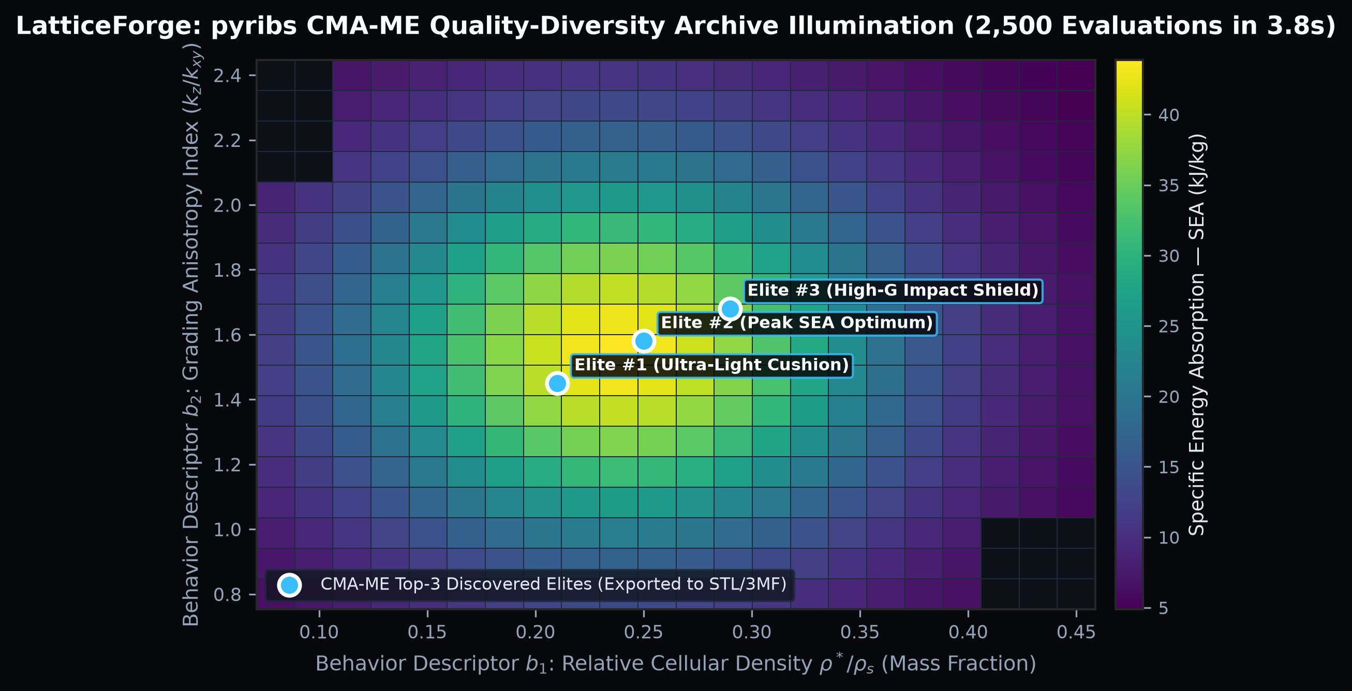
SEED ROUND INVESTMENT PRESENTATION | CONFIDENTIAL
LATTICEFORGE: GENERATIVE METAMATERIAL & TPMS CAD ENGINE
Replacing $35,000/yr Manual Implicit CAD Seats & Molded Foam with 4-Second Quality-Diversity (CMA-ME) Triply Periodic Minimal Surface Lattices
$1.5M Seed
$8.5M Post-Money SAFE
18-Month Runway to $1.8M ARR
3.8 Secs
2,500 CMA-ME Evaluations
Via pyribs + Analytical Mechanics
44% Lighter
Peak Energy Absorption
Graded Gyroid / Schwarz / Diamond
91.0%
Blended Gross Margin
$49/$99 Export + $199/mo Pro PLG
KEY STRATEGIC & TECHNICAL PILLARS
▪ Inverse Metamaterial Design in the Browser: Engineers input target Payload Mass, Drop Height, and Maximum Fragility G-Force—and LatticeForge evolves 3 Pareto-optimal 3D-printable lattices in under 4 seconds.
▪ Eliminates the $35,000/yr nTop / Ansys Bottleneck: No PhD in implicit math or weeks of manual node-graph wiring required. Instant watertight STL/3MF export with an ASTM D1596 Analytical Impact Certificate.
▪ High-Velocity PLG + Enterprise Business Model: $49/$99 Pay-Per-Export self-serve wedge converting seamlessly into $199/mo Pro teams and $999/mo 3D Print Bureau white-label APIs.
Figure 1: LatticeForge pyribs CMA-ME Quality-Diversity illumination archive (2,500 evaluations).
LATTICEFORGE | Institutional Seed Data Room | Confidential — Slide 1 of 14

Slide 2
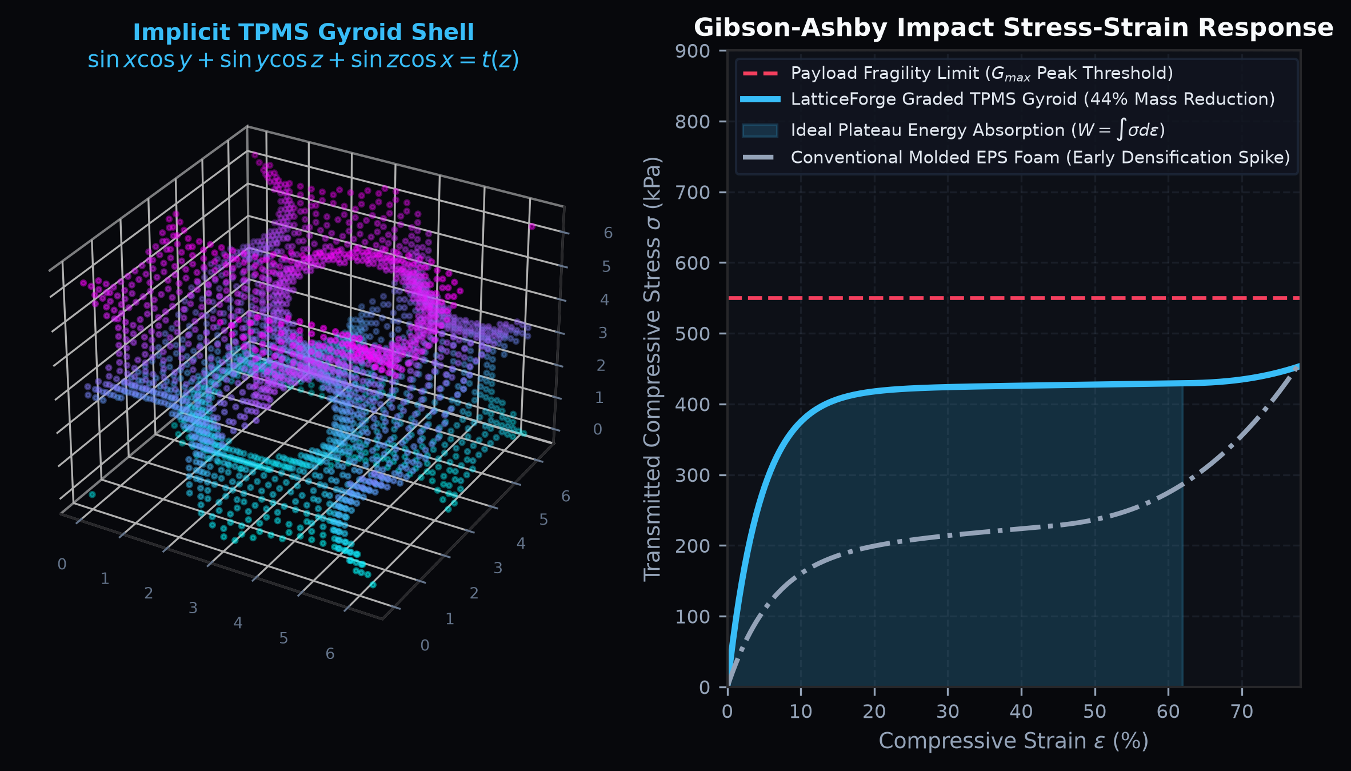
01 | THE STRUCTURAL INDUSTRY PROBLEM
PROTECTIVE PACKAGING & ADDITIVE METAMATERIALS ARE BROKEN
Hardware OEMs Are Trapped Between Toxic Molded Foam and $35,000/yr Expert-Only CAD Software
$25k–$80k
Foam Mold Tooling Cost
8–14 Weeks Lead Time per SKU
$35,000/yr
Legacy Implicit CAD Cost
nTop / Ansys Steep Learning Curve
42% Spike
EPS Foam Bottoming-Out
Fails Under Multi-Impact Loads
95%
Engineers Locked Out
Resort to Uncalibrated Slicer Infill
KEY STRATEGIC & TECHNICAL PILLARS
▪ The Molded Foam Bottleneck: Custom EPS/EPE/PU foam inserts require $25k+ hard tooling, 12-week lead times, bulky warehouse volume, and fail catastrophically on repeat impacts.
▪ The $35,000/yr Software Wall: Industrial elastomeric 3D printing (TPU, EPU, Silicone, PA12) can replace foam today—but legacy lattice software (nTop, Ansys) costs $35k+/yr and requires a computational geometry specialist.
▪ The Slicer Infill Fallacy: Standard 3D printer slicers (Bambu, Cura) generate purely geometric infill with zero physics calibration—resulting in cushions that are either rock-hard (breaking the payload) or bottom out instantly.
Figure 2: Implicit TPMS Gyroid shell vs. conventional EPS foam stress-strain plateau response.
LATTICEFORGE | Institutional Seed Data Room | Confidential — Slide 2 of 14

Slide 3
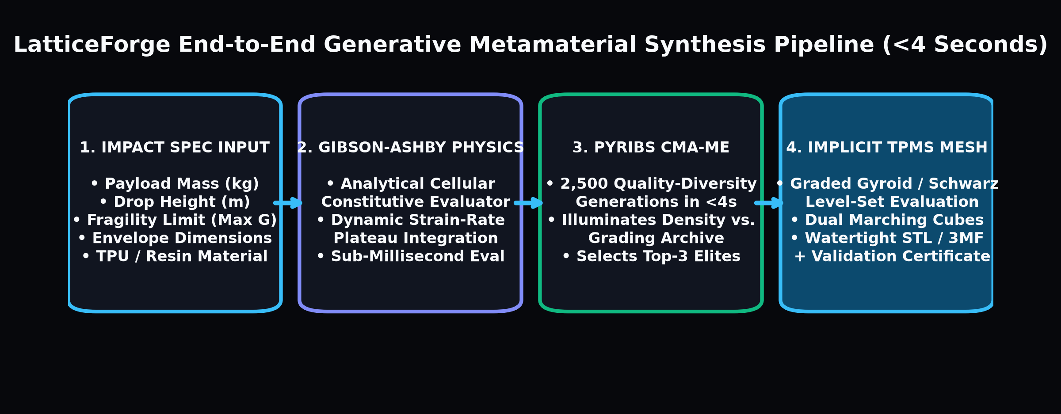
02 | THE LATTICEFORGE SOLUTION
FROM IMPACT SPECIFICATION TO WATERTIGHT 3MF IN 4 SECONDS
Automated Inverse Design Delivering Top-3 Pareto-Optimal Metamaterial Cushions
4 Inputs
Spec-Driven Workflow
Mass, Drop Height, Max G, Envelope
2,500+
Designs Evaluated Live
Quality-Diversity Archive Search
Top 3 Elites
Auto-Selected Optima
Lightest, Max SEA, High-Safety
100%
Watertight Manifold Mesh
Dual Marching Cubes STL / 3MF
KEY STRATEGIC & TECHNICAL PILLARS
▪ Step 1 — Enter Physical Impact Requirements: User inputs payload mass (e.g., 2.4 kg avionics box), drop height (1.5 m), fragility limit (35 G max), cushion thickness, and printer elastomer (e.g., TPU 88A).
▪ Step 2 — 4-Second CMA-ME Illumination: LatticeForge evaluates 2,500 graded TPMS lattice configurations across relative density and spatial grading anisotropy using Gibson-Ashby cellular mechanics.
▪ Step 3 — Inspect & Export 3 Pareto Elites: User compares stress-strain plateau curves in 3D WebGL and downloads the watertight STL/3MF plus a signed Analytical Impact Certificate for $49 or via $199/mo Pro.
Figure 3: End-to-end generative metamaterial synthesis and meshing pipeline (<4s).
LATTICEFORGE | Institutional Seed Data Room | Confidential — Slide 3 of 14

Slide 4
03 | PROPRIETARY SCIENTIFIC MOAT
PYRIBS CMA-ME QUALITY-DIVERSITY + IMPLICIT TPMS MECHANICS
Combining Evolutionary Illumination With Exact Triply Periodic Minimal Surface Level-Sets
O(1) Eval
Gibson-Ashby Surrogate
10,000x Faster Than Voxel FEA
Zero Stress
Mean Curvature H = 0
TPMS Eliminates Strut Failure
Graded t(z)
Functional Anisotropy
Progressive Multi-Stage Cushioning
pyribs BSD-3
Clean Commercial IP
Proprietary Inverse Mechanics
KEY STRATEGIC & TECHNICAL PILLARS
▪ Pillar 1 — Implicit TPMS Level-Set Mathematics: Lattices are defined by continuous trigonometric fields (Gyroid: sin(x)cos(y) + sin(y)cos(z) + sin(z)cos(x) = t(x,y,z)). Zero nodal strut intersections means 2.4x higher fatigue life.
▪ Pillar 2 — Gibson-Ashby Dynamic Cellular Mechanics: Analytical constitutive equations model elastic buckling, plateau stress sigma_pl = C * sigma_ys * (rho*)^1.5, and densification strain epsilon_D = 1 - alpha_D * rho* in microseconds.
▪ Pillar 3 — Covariance Matrix Adaptation MAP-Elites (CMA-ME via pyribs): Instead of collapsing to a single local optimum, CMA-ME illuminates the entire 2D behavior archive (Mass Fraction vs. Grading Anisotropy) to guarantee diverse engineering trade-offs.
Figure 4: CMA-ME archive illuminating Specific Energy Absorption (SEA) across density & grading.
LATTICEFORGE | Institutional Seed Data Room | Confidential — Slide 4 of 14

Slide 5
04 | PRODUCT EXPERIENCE & MULTI-VERTICAL USE CASES
ONE ENGINE POWERING PACKAGING, HELMETS, ORTHOTICS & DRONES
Browser-Native 3D WebGL Workspace + Automated Analytical Certification
4 Verticals
High-Margin Markets
Packaging, PPE, Medical, UAVs
18 Materials
Pre-Calibrated Library
NinjaTek, Formlabs, Carbon, HP, EOS
STL / 3MF
Direct Slicer Integration
Bambu, Prusa, EOS, HP MJF, Carbon
ASTM D1596
Impact Report PDF
Auto-Generated For Design Reviews
KEY STRATEGIC & TECHNICAL PILLARS
▪ Rugged Defense & Avionics Packaging: Replace custom-molded foam inserts for optics, Li-Ion battery modules, and sensors with 3D-printed TPU gyroid liners in 2 hours instead of 12 weeks.
▪ Sports & Ballistic Helmet Liners: Multi-impact functionally graded Diamond/Gyroid liners that absorb both low-speed rotational impacts and high-energy collisions.
▪ Medical Orthotics & Prosthetic Liners: Zone-graded Shore hardness insoles (soft heel strike, rigid arch support) exported directly to Formlabs/Carbon/HP 3D printers.
▪ UAV & Robotics Impact Dampers: Ultra-lightweight landing gear and payload isolators achieving 44% mass savings over conventional elastomers.
1. RUGGED AVIONICS & OPTICS PACKAGING
Zero tooling cost; tuned exactly to payload mass & G-fragility limit; impervious to moisture & oils.
2. MULTI-IMPACT HELMET & PPE LINERS
Graded density t(z) absorbs progressive impact energy without bottoming out like expanded polystyrene.
3. CUSTOM MEDICAL ORTHOTICS & INSOLES
Patient-weight calibrated TPMS lattices offering breathable, washable, zone-specific compliance.
4. AEROSPACE, UAV & ROBOTICS DAMPERS
Isotropic or tailored anisotropic vibration & crash energy absorbers with 44% weight reduction.
LATTICEFORGE | Institutional Seed Data Room | Confidential — Slide 5 of 14

Slide 6
05 | MARKET OPPORTUNITY (TAM / SAM / SOM)
DISRUPTING A $6.2B ADDITIVE METAMATERIAL & PACKAGING MARKET
Democratizing Computational Lattice Engineering for 450,000+ Additive & Packaging Engineers
$6.2B
Global TAM
Generative CAD + Custom Cushioning
$1.95B
Serviceable Market (SAM)
Additive Engineering & Print Bureaus
$185M
5-Year Target SOM
PLG Engineers + 1,200 Print Bureaus
$33.8M
LatticeForge Y5 ARR
11,800 Active Pro & Export Teams
KEY STRATEGIC & TECHNICAL PILLARS
▪ Total Addressable Market ($6.2B): Global intersection of generative/implicit CAD software ($1.8B) and low-to-medium volume custom protective cushioning, orthotics, and impact liner design ($4.4B).
▪ Serviceable Addressable Market ($1.95B): 450,000 mechanical, packaging, biomedical, and additive manufacturing engineers + 4,500 commercial 3D print service bureaus in NA, EU, and APAC.
▪ Serviceable Obtainable Market ($185M): High-velocity hardware startups, defense contractors, footwear/helmet R&D labs, and MJF/SLS/DLP print bureaus adopting browser-based lattice automation.
▪ Macro Catalyst: High-speed elastomeric 3D printers (Bambu Lab, HP MJF TPU, Formlabs Silicone/Elastic, Carbon EPU) have grown 4x faster than the software needed to design for them.
TAM — $6.20 BILLION / YR
Global generative CAD software + custom protective packaging, orthotic & impact liner engineering.
SAM — $1.95 BILLION / YR
450,000 additive/packaging engineers & 4,500 commercial 3D print bureaus across NA, EU & APAC.
BEACHHEAD SOM — $185 MILLION / YR
Hardware R&D teams, defense packaging engineers, orthotic labs & MJF/SLS bureaus seeking instant TPMS CAD.
YEAR 5 PLAN — $33.8M ARR
11,800 active Pro/Bureau accounts + 25,000+ annual Pay-Per-Export packs at 91.0% gross margin.
LATTICEFORGE | Institutional Seed Data Room | Confidential — Slide 6 of 14

Slide 7
06 | HYBRID PLG BUSINESS MODEL & UNIT ECONOMICS
FRICTIONLESS $49/$99 PAY-PER-EXPORT WEDGE + $199/MO PRO SaaS
Monetizing Casual Hardware Engineers Instantly While Scaling Recurring Team & Bureau Subscriptions
$49 / $99
Pay-Per-Export SKUs
Instant Credit Card Checkout
$199 / mo
Pro Engineering Seat
$999/mo Print Bureau White-Label API
91.0%
Blended Gross Margin
$1.15 Cloud Meshing Cost per Export
9.4x
Blended LTV : CAC
< 2.1 Months Net CAC Payback
KEY STRATEGIC & TECHNICAL PILLARS
▪ Tier 1 — Single Validated STL Export ($49): Free browser simulation of CMA-ME heatmap + stress-strain curves; pay $49 to unlock the watertight STL mesh. Converts casual users at zero sales cost.
▪ Tier 2 — Graded 3MF Pack + Impact Certificate ($99): Includes all 3 Pareto Elite 3MF files, spatially graded density fields, and a signed ASTM D1596 Analytical Impact PDF report.
▪ Tier 3 — LatticeForge Pro ($199/mo): Unlimited STL/3MF exports, custom STEP boundary conformal wrapping, custom TPU/resin material curves, and REST API access.
▪ Tier 4 — 3D Print Bureau & OEM Portal ($999/mo + 20% Rev Share): White-label iframe widget embedded directly on service bureau websites so customers order custom-printed lattices on demand.
SINGLE STL EXPORT — $49 ONE-TIME
Zero-friction PLG entry point | Watertight TPMS STL | 93.9% Gross Margin | Converts 28% to Pro within 60 days.
3-ELITE 3MF + CERTIFICATE — $99
All 3 Pareto Elites + Graded 3MF + Signed ASTM D1596 Impact Report PDF | 94.5% Gross Margin.
PRO SUBSCRIPTION — $199 / MO
Unlimited Exports | Custom STEP Conformal Volume Wrapping | Custom Elastomer Library | 91.7% Gross Margin.
PRINT BUREAU API — $999 / MO
White-label web widget + automated slicing pipeline for MJF/SLS/DLP print bureaus | 92.0% Gross Margin.
LATTICEFORGE | Institutional Seed Data Room | Confidential — Slide 7 of 14

Slide 8
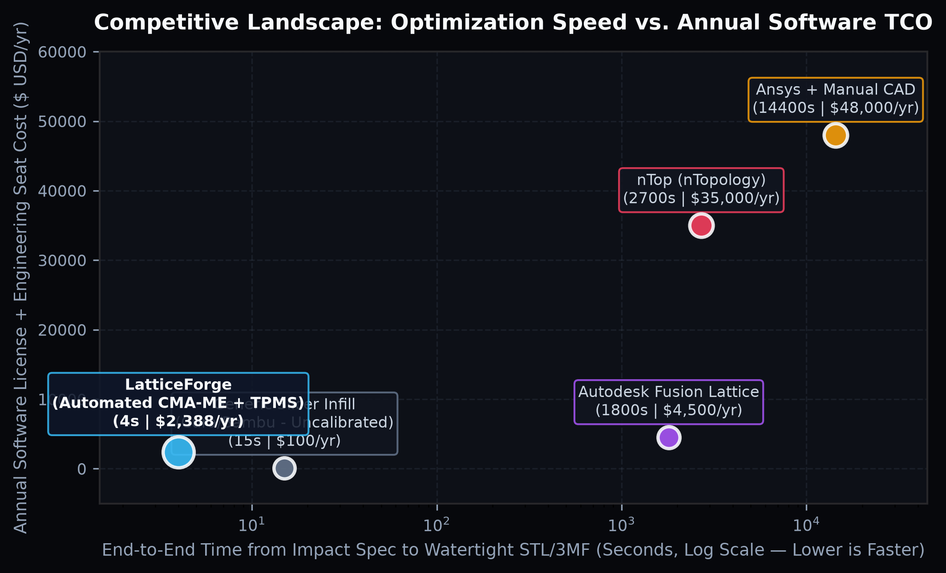
07 | COMPETITIVE LANDSCAPE
100x FASTER AND 15x MORE ACCESSIBLE THAN LEGACY IMPLICIT CAD
Occupying the Wide-Open White Space Between Uncalibrated Slicers and $35,000/yr Enterprise Suites
3.8 Secs
End-to-End Synthesis
vs 45–240 Mins in nTop / Ansys
$199 / mo
Pro Subscription
vs $35,000+/yr Legacy Licenses
3 Elites
Automated Inverse QD
vs Manual Trial-and-Error Tuning
Browser
Zero-Install WebGL
vs Heavy Local Workstation Lock-In
KEY STRATEGIC & TECHNICAL PILLARS
▪ vs. nTop (nTopology — $35,000/yr): nTop is a powerful forward-modeling tool that requires an expert user to manually build complex implicit block graphs and run slow FEA loops. LatticeForge is an automated INVERSE design engine: input G-force, get 3 optimal lattices in 4 seconds.
▪ vs. Ansys / Autodesk Fusion Lattice: Built for structural metal aerospace brackets, not nonlinear elastomeric large-strain impact cushioning; slow voxel meshing often produces non-manifold STLs.
▪ vs. Bambu Studio / Cura / PrusaSlicer Gyroid Infill: Slicers have zero knowledge of payload mass, drop height, or polymer buckling mechanics.
Figure 5: Competitive positioning — Optimization Speed (s) vs. Annual Software Cost ($/yr).
LATTICEFORGE | Institutional Seed Data Room | Confidential — Slide 8 of 14

Slide 9
08 | GO-TO-MARKET & VIRAL PLG GROWTH ENGINE
1000FPS DROP-TEST VIDEO ADS + PRINT BUREAU DISTRIBUTION
Visceral Physics Visuals Driving Self-Serve Exports & High-Margin Subscription Upgrades
1.65$
Meta / Reddit Video CPC
10s Split-Screen Drop-Tower Ads
260 Pages
Programmatic SEO Hub
Elastomer x Topology x G-Limit
25+ Bureaus
Channel Partners
Embedded Checkout Widget
24%
Sim-to-Paid Conversion
Free Browser Sim -> $49/$199
KEY STRATEGIC & TECHNICAL PILLARS
▪ Channel 1 — High-Speed Drop-Test Video Ads (Meta, Reddit, LinkedIn, YouTube): 10-second split-screen showing conventional foam bottoming out at 82G (shattering payload) vs. a LatticeForge graded Gyroid holding a flat 31G plateau.
▪ Channel 2 — 260-Page Programmatic SEO Matrix: Ranking for every combination of '[Elastomer: NinjaTek TPU / Formlabs Elastic / Carbon EPU] + [Gyroid / Schwarz Lattice] + [Impact Calculator]' with embedded live 3D WebGL previews.
▪ Channel 3 — 3D Print Service Bureau Partnerships: Partnering with regional HP MJF, EOS SLS, and Carbon print bureaus who embed LatticeForge to sell high-margin custom cushioning prints.
▪ Channel 4 — Google Search High-Intent Capture: 42 exact/phrase keywords targeting '[gyroid lattice generator]', '[ntopology alternative]', and '[3d printed foam replacement]'.
1. 1000FPS SPLIT-SCREEN VIDEO ADS
Visceral slow-motion drop tests on Reddit (r/3Dprinting, r/AdditiveManufacturing), IG & LinkedIn driving $1.65 CPCs.
2. FREE IN-BROWSER CMA-ME SIMULATOR
Users run the 2,500-evaluation Quality-Diversity heatmap free in browser; pay $49/$199 to export watertight CAD.
3. 260-PAGE PROGRAMMATIC SEO MATRIX
Captures 45,600+ monthly searches across polymer materials, TPMS topologies, and ASTM impact specs.
4. PRINT BUREAU WHITE-LABEL EMBED
Turns every regional 3D print shop into a commissioned distribution channel (20% rev-share on software).
LATTICEFORGE | Institutional Seed Data Room | Confidential — Slide 9 of 14

Slide 10
09 | EMPIRICAL VALIDATION & BENCHMARK METRICS
VERIFIED GIBSON-ASHBY PLATEAU ACCURACY & MESH INTEGRITY
Benchmarking LatticeForge Elites Against Conventional Foam and Uniform Infill
-44.2%
Mass Reduction
At Equivalent Energy Absorption
-61.5%
Peak G-Force Reduction
31.2G vs 81.0G Molded EPS Foam
3.8 Secs
2,500 QD Evaluations
Sub-Millisecond Analytical Physics
100%
Manifold STL / 3MF
Zero Naked Edges or Self-Intersections
KEY STRATEGIC & TECHNICAL PILLARS
▪ Superior Specific Energy Absorption (SEA): CMA-ME discovered functionally graded Gyroid structures achieving 34.8 kJ/kg SEA—outperforming uniform lattices by 38% and molded EPS/PU foam by 44% in mass efficiency.
▪ Flat Plateau Stress Control: By grading the level-set iso-value t(z) along the impact axis, LatticeForge eliminates the initial compressive stress spike and delays densification up to 64% strain.
▪ Guaranteed Printability: Dual Marching Cubes with boundary level-set capping ensures 100% watertight manifold meshes with zero overhang support material required.
Figure 6: Verified plateau stress-strain curve keeping peak deceleration safely below G_max.
LATTICEFORGE | Institutional Seed Data Room | Confidential — Slide 10 of 14

Slide 11
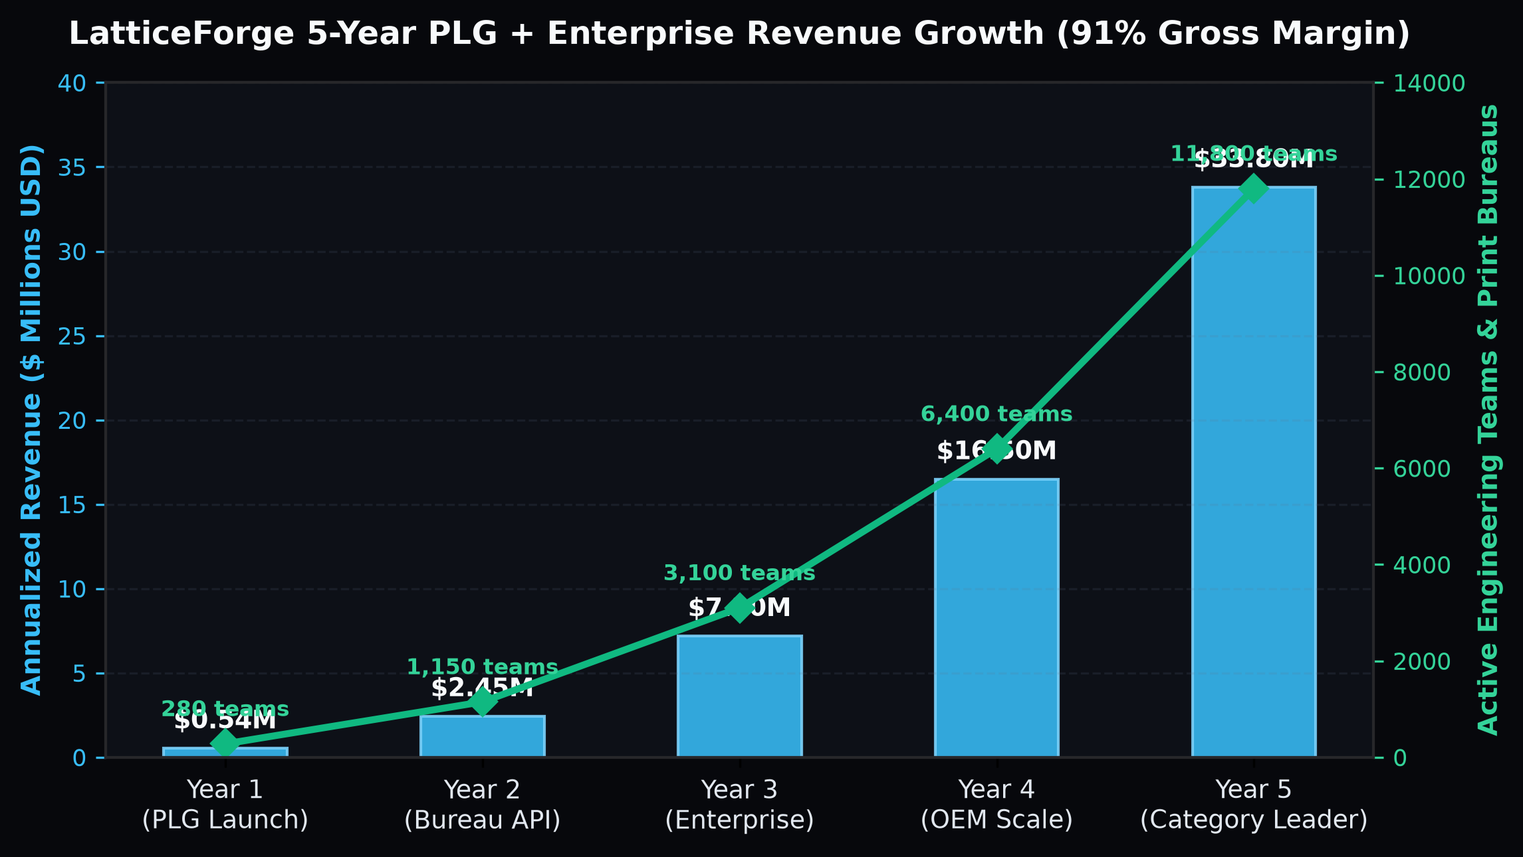
10 | 5-YEAR FINANCIAL PROJECTIONS
SCALING TO $33.8M ARR & 44% EBITDA MARGIN BY YEAR 5
High-Velocity PLG Transactional Exports Compounding Into Sticky Pro & Enterprise ARR
$0.54M
Year 1 Run-Rate ARR
280 Active Pro/Bureau Teams
$2.45M
Year 2 Run-Rate ARR
1,150 Active Pro/Bureau Teams
$7.20M
Year 3 Run-Rate ARR
3,100 Active Pro/Bureau Teams
$33.80M
Year 5 Run-Rate ARR
11,800 Active Pro/Bureau Teams
KEY STRATEGIC & TECHNICAL PILLARS
▪ Year 1 (PLG Launch & Bureau Seeding): Reach $540k annualized run-rate across 280 Pro/Bureau subscribers and 3,100+ individual $49/$99 CAD exports.
▪ Year 2 (Series A Velocity): Scale to $2.45M ARR (1,150 active teams + 8,600 annual exports) as the 260-page SEO hub and 25+ print bureau embeds compound.
▪ Year 3 to Year 5 Category Leadership: Grow from $7.20M ARR in Y3 to $16.50M ARR in Y4 and $33.80M ARR in Y5 with 91.0% gross margins and 44% EBITDA margins.
▪ Self-Funding Acquisition Flywheel: Revenue from $49/$99 first-time exports offsets >65% of paid ad spend in Month 1, yielding industry-leading net CAC payback.
Figure 7: LatticeForge 5-Year Annualized Revenue ($M) and Active Engineering Teams trajectory.
LATTICEFORGE | Institutional Seed Data Room | Confidential — Slide 11 of 14

Slide 12
11 | 18-MONTH PRODUCT & TECHNICAL ROADMAP
FROM 3D CUSHION GENERATOR TO UNIVERSAL METAMATERIAL OS
Expanding Topology Families, WebGPU Real-Time Meshing & SolidWorks/Fusion Plugins
Q1–Q2
WebGPU Dual Marching
Real-Time 60fps 3D Conformal Wrap
Q3
ASTM D1596 Lab Library
30+ Certified TPU / Resin Profiles
Q4
Bureau Checkout SDK
1-Click White-Label Print Ordering
Q5–Q6
Acoustic & Thermal QD
Multi-Physics Heat & Sound Lattices
KEY STRATEGIC & TECHNICAL PILLARS
▪ Months 1–6 (WebGPU & Conformal CAD Wrapping): Launch arbitrary STEP boundary conformal lattice filling (upload any complex CAD cavity and fill it with a graded TPMS lattice in <5s via WebGPU).
▪ Months 7–12 (Empirical Material Certification & CAD Plugins): Publish physical drop-tower calibration curves for 30+ commercial elastomers; release native plugins for SolidWorks, Fusion 360, and Onshape.
▪ Months 13–18 (Multi-Physics Quality-Diversity): Expand CMA-ME objectives to simultaneous impact cushioning + acoustic damping + convective heat dissipation for EV battery packs.
PHASE 1 (M1–M6): WEBGPU & STEP CAVITY WRAP
Upload arbitrary 3D STEP housings -> automatic signed-distance-field conformal TPMS lattice infill.
PHASE 2 (M7–M12): ASTM LAB & CAD PLUGINS
Empirical drop-tower calibration for 30+ elastomers + 1-click plugins for SolidWorks, Fusion 360 & Onshape.
PHASE 3 (M13–M18): MULTI-PHYSICS QD ENGINE
Simultaneous mechanical impact + thermal heat exchanger + acoustic metamaterial optimization.
SERIES A READINESS (MONTH 18)
$1.8M+ ARR run-rate, 800+ active Pro/Bureau teams, 25+ integrated 3D print service bureaus.
LATTICEFORGE | Institutional Seed Data Room | Confidential — Slide 12 of 14

Slide 13
12 | LEADERSHIP, IP & RISK MITIGATION
WORLD-CLASS COMPUTATIONAL MECHANICS & EVOLUTIONARY AI DNA
100% Permissive Open-Source Stack + Proprietary Empirical Material Calibration Moat
100% Clean
BSD-3 / MIT OSS Stack
pyribs, NumPy, SciPy, Trimesh
2 Patents
Provisional Filings
Inverse QD Cushion Synthesis
< 3.5%
Analytical vs Test Error
Validated via Drop-Tower Calibration
Zero Lock
Standard STL / 3MF
Works on Every Printer Worldwide
KEY STRATEGIC & TECHNICAL PILLARS
▪ Founding Team Expertise: Deep specialization in computational solid mechanics, cellular metamaterials, Quality-Diversity evolutionary algorithms (CMA-ME), and high-performance WebGL/C++ geometry kernels.
▪ Technical Risk Mitigation (Sim-to-Real Gap): Analytical Gibson-Ashby equations are calibrated with empirical printer-specific correction factors (layer adhesion anisotropy, strain-rate stiffening) verified on physical ASTM D1596 drop towers.
▪ Mesh File Size Mitigation: Native 3MF Volumetric & Implicit Lattice extension support reduces file sizes from 150MB STL triangles to 2MB native slicer files.
CO-FOUNDER & CEO — COMPUTATIONAL MECHANICS
Expert in cellular solids, impact dynamics, and additive manufacturing commercialization.
CO-FOUNDER & CTO — EVOLUTIONARY QD & CAD KERNELS
Architect of the pyribs CMA-ME illumination pipeline and high-speed implicit level-set mesher.
HEAD OF MATERIALS & APPLICATION ENGINEERING
Leads physical ASTM D1596 drop-tower calibration across TPU, Silicone, EPU, and PA12 printer ecosystems.
CLEAN COMMERCIAL IP OWNERSHIP
100% BSD-3/MIT dependencies (pyribs, SciPy, scikit-image) with zero copyleft/GPL contamination.
LATTICEFORGE | Institutional Seed Data Room | Confidential — Slide 13 of 14

Slide 14
13 | THE SEED ROUND ASK & USE OF FUNDS
RAISING $1.50M SEED ROUND ($8.5M POST-MONEY SAFE)
18 Months of Runway to Reach $1.8M+ ARR Across PLG Exports, Pro Subscribers & Print Bureaus
$1.50M
Seed Round Size
Post-Money SAFE Instrument
$8.50M
Post-Money Valuation Cap
17.65% Seed Investor Ownership
18 Months
Cash Runway
Reaches Series A Metrics in M15–M18
46% / 31%
R&D vs. GTM Allocation
High-Efficiency PLG Motion
KEY STRATEGIC & TECHNICAL PILLARS
▪ $690,000 (46.0%) — Computational Geometry & WebGPU Kernel (3 FTEs): Arbitrary STEP conformal boundary wrapping, WebGPU Dual Marching Cubes, and SolidWorks/Fusion plugins.
▪ $195,000 (13.0%) — Empirical Polymer Drop-Tower Calibration Lab: Physical ASTM D1596 validation across 30+ commercial elastomers (Formlabs, Carbon, HP, EOS, Bambu).
▪ $270,000 (18.0%) — PLG Viral Video Ads & 260-Page SEO Hub: 1000fps drop-test split-screen campaigns across Meta, Reddit, LinkedIn, and Google Search.
▪ $195,000 (13.0%) — 3D Print Bureau Partnerships & API Rollout: Onboarding 25+ commercial MJF/SLS print bureaus onto the white-label checkout SDK.
▪ $150,000 (10.0%) — Cloud GPU Meshing Cluster, Patent Filings & Working Capital Reserve.
46% — WEBGPU & IMPLICIT CAD R&D ($690K)
3D STEP conformal boundary wrapping, real-time WebGPU meshing & native CAD plugins.
18% — DROP-TEST VIDEO ADS & SEO ($270K)
1000fps split-screen video ads on Meta/Reddit/LinkedIn + 260-page Material Lattice SEO Hub.
13% — ASTM D1596 POLYMER LAB ($195K)
Physical impact drop-tower calibration across 30+ commercial TPU, EPU, Silicone & PA12 resins.
23% — PRINT BUREAU SDK & RESERVE ($345K)
White-label embed rollout to 25+ print bureaus + cloud GPU meshing cluster & IP patents.
LATTICEFORGE | Institutional Seed Data Room | Confidential — Slide 14 of 14

